Slide 1

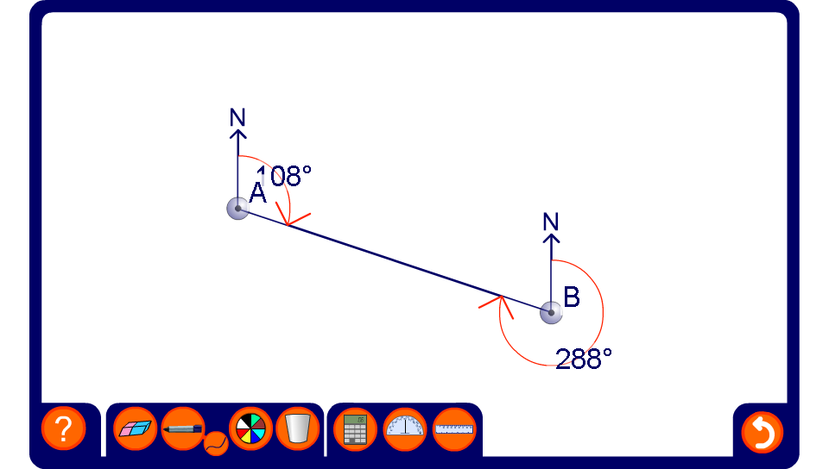


Investigating back bearings
Notes:
If a given bearing is less than 180º, we find the reciprocal or back bearing by adding 180°. If a given bearing is more than 180º, we find the back bearing by subtracting 180°.

